Slide 1
Finding Data On the web

Slide 2
Finding Data on the Web
Data Sources Online
Twitter!
Think tanks, NGOs and academics and government
Advanced Google Searches
Exercise
Summary & Conclusions

Slide 3
Finding Data on the Web
Data tweets
@RamziJaber
@YasminWaQahwa
@AWAyyad
@SabrienAmrov
@phil_haqeeqa
@MaliciaRogue
@shadi3000
@rewiram
@gr33ndata

Slide 4
Finding Data on the Web
Data Sources Online
Twitter!
Think tanks, NGOs, academics and government
Advanced Google Searches
Exercise
Summary & Conclusions

Slide 5
Finding Data on the Web
Think tanks, NGOs, academics and government
Read the public reports and analyze the data before calling
Ask questions to help you understand how the data was collected
Corroborate your findings with experts
Ask for related data

Slide 6
Finding Data on the Web
Data Sources Online
Twitter!
Think tanks, NGOs, academics and government
Advanced Google Searches
Exercise
Summary & Conclusions

Slide 7
Finding Data on the Web:
Data Formats for Download
Portable Document Format (PDF): charts that contain data but are saved in a unified document with text
Excel file (xls): data is saved as a table readable by Microsoft Excel
Comma separated values (CSV): Plain text file with each data separated by a comma

Slide 8
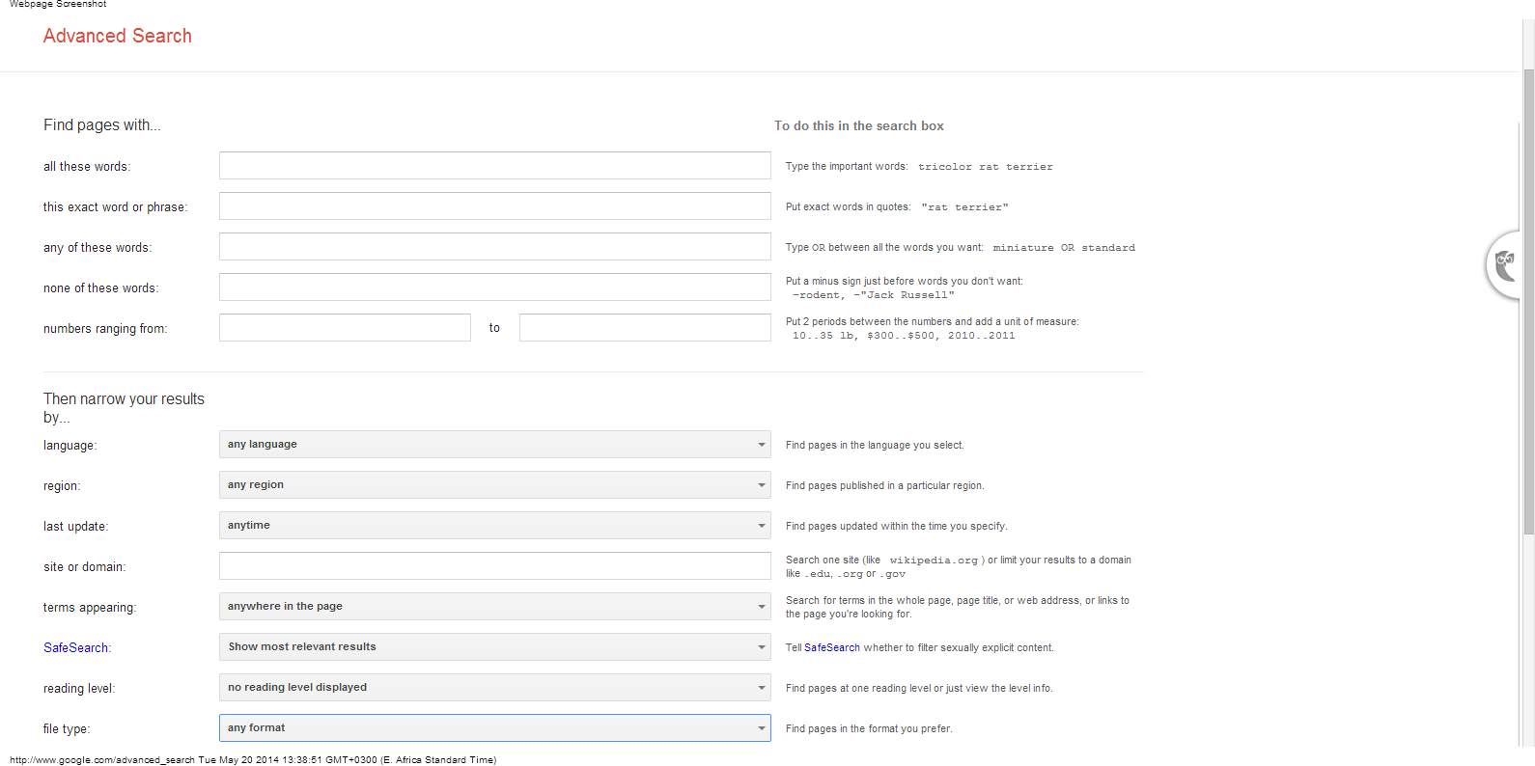
Finding Data on the Web:
Google Advanced Searches

Slide 9
Finding Data: Advanced Google Searches Shortcuts
Type OR to find variations of the same search: Palestine economic “sanctions” OR “injunction” OR “penalties”
Use quotes to search for phrases “Palestine Investment Promotion Agency”
Narrow search to specific website: “site:url” Example site:http://www.pipa.gov.ps/taxation.asp tax rate
Narrow search to filetype: “Filetype:[extension]”
Example: site:www.tradingeconomics.com filetype:pdf Palestine
Also try http://www.google.com/advanced_search
Google alerts: get notified about your beat

Slide 10
Finding Data on the Web: Exercise
Get back into your two groups:
Israel harms Palestinian economy: report
$40 Million World Bank Grant to Support the Palestinian Authority’s Reform Priorities

Slide 11
Finding Data on the Web: Exercise
Return to your lists of data that would enrich economic coverage
Search for data using databases and advanced searches.
Categorize the data you have by story angle

Slide 12
Finding Data: No Excuses!
“We don’t have that data on a computer.”
High fees
Delay tactics
“Your request was unclear.”
Sending the wrong data
“Our database is too complicated to give you access.”
“Our database software is proprietary.”
“That information is protected by privacy law.”

Slide 13
Summary & Resources
Data is available in many different formats and almost always you will need to convert data to an Excel or csv file.
Every day, more data is available online and accessible through searches
If you can’t find it online, don’t give up!

